Slide 1

Team Creation Presents
Capstone Project
EDA ON Hotel Booking
Analysis
• Bipasha Zade
• Chinmay Rojatkar (Team Leader)
• Deepali Mahajan
• Kunal Gawande
• Nikhil Aggarwal

Slide 2

Points to Discuss:-
While doing the complete analysis the Team has created the pointers in
the form of the Index which can be find below:-
• Agenda
• Data Conclusion
• Bivariate Analysis
• Hotel wise Analysis
• Cancelation Analysis
• Time wise Analysis

Slide 3

Data Collection and Understanding:
Data Description:
• hotel :Resort Hotel or City Hotel
• is_canceled : Value indicating if the booking was canceled (1) or not (0)
• lead_time : Number of days that elapsed between the entering date of the booking and the
arrival date
• arrival_date_year : Year of arrival date
• arrival_date_month : Month of arrival date
• arrival_date_week_number : Week number of year for arrival date
• arrival_date_day_of_month : Day of arrival date
• stays_in_weekend_nights : Number of weekend nights
• stays_in_week_nights : Number of week nights.
• adults : Number of adults
• children : Number of children
• babies : Number of babies
• meal : Type of meal booked.
• country : Country of origin.

Slide 4
• market_segment : Market segment designation. (TA/TO)
• distribution_channel : Booking distribution channel.(T/A/TO)
• is_repeated_guest : is a repeated guest (1) or not (0)
• previous_cancellations : Number of previous bookings that were cancelled by the customer prior to the current booking
• previous_bookings_not_canceled : Number of previous bookings not cancelled by the customer prior to the current
booking
• reserved_room_type : Code of room type reserved.
• assigned_room_type : Code for the type of room assigned to the booking.
• booking_changes : Number of changes made to the booking from the moment the booking was entered on the PMS
until the moment of check-in or cancellation
• deposit_type : No Deposit, Non Refund , Refundable. agent : ID of the travel agency that made the booking company : ID
of the company/entity that made the booking .
• days_in_waiting_list : Number of days the booking was in the waiting list before it was confirmed to the customer
• customer_type : type of customer. Contract,Group,transient,Transient party.
• adr : Average Daily Rate as defined by dividing the sum of all lodging transactions by the total number of staying nights
• required_car_parking_spaces : Number of car parking spaces required by the customer
• total_of_special_requests : Number of special requests made by the customer (e.g. twin bed or high floor)
• reservation_status : Reservation last status.

Slide 5
Agenda:-
• The Main center of discussion is the analysis of given hotel
bookings data set from 2015-2017.
• The Team Creation has done the analysis of given data set in
following ways:-
1.Bivariate Analysis
2.Hotel wise analysis
3.Distribution wise Analysis.
4.Cancelation Analysis.
5.Time Wise Analysis.

Slide 6
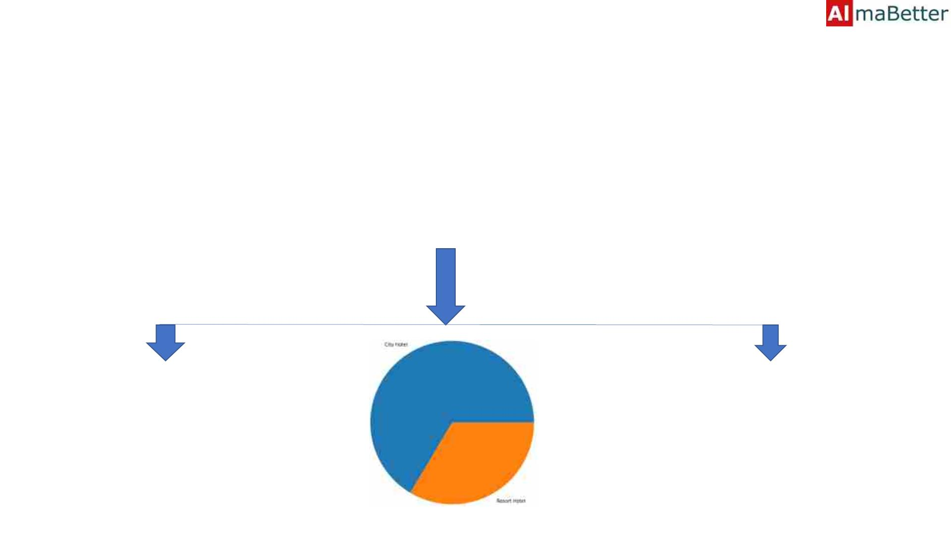
Data Conclusion:-
Provided data set has different columns of variables crucial for hotel
bookings. Few of them are as below:
• Hotel: The category of Hotels. There are 2 Categories of the Hotel:-
City Hotel
Resort Hotel

Slide 7

Data Conclusion(Continued):-
Cancelled:- The value of this
column shows the
cancellation type. Either the
booking were cancelled or
not.
Where the values have been
indicated as:-
Values[0,1], where 0 indicates
not cancelled.
1 Indicates as Cancelled

Slide 8

Data Conclusion(Continued):-
• Customer Types:- This Includes either the Customer is an Adult,
Children or the Toddler(Babies).

Slide 9
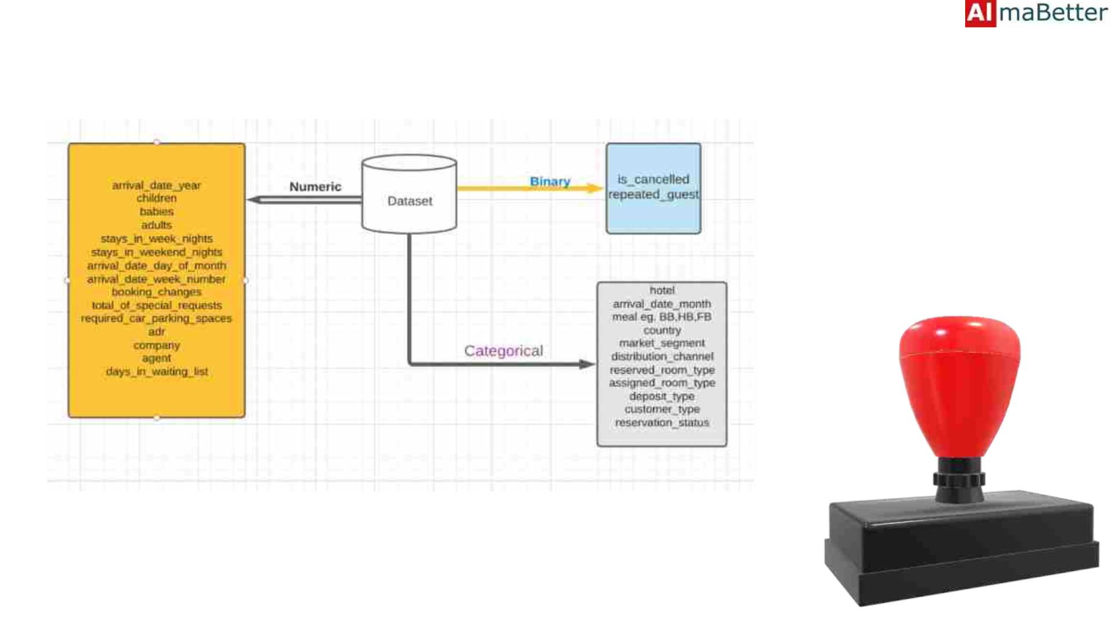
Data Conclusion

Slide 10
Bivariate Analysis:-
• While doing Bivariate analysis of the given hotel booking dataset, we
tried to figured answering the following questions:
1. Which room type is in the demand?
2. Which room type generated highest Revenue?
3. In Which Year the Highest Number of Rooms booked by the each
type of the Hotel?
4. Maximum Number of the Rooms booked by ?
5. In which Month the Highest Number of Customers came?

Slide 11
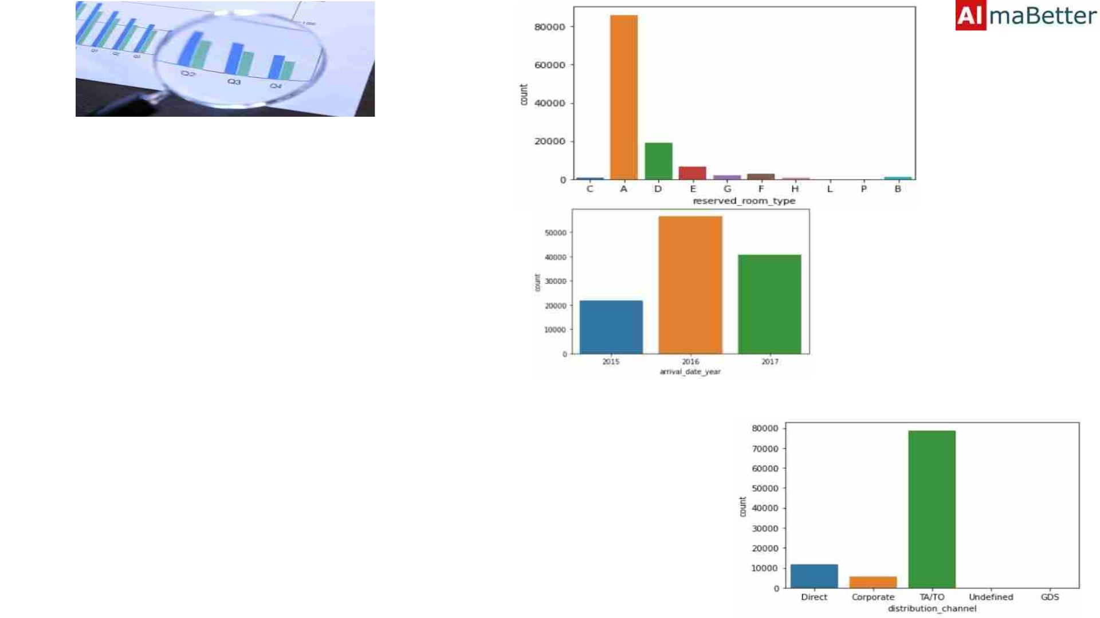
• Type of the Room A is in most demand
by the Customers.
• Type of the Rooms D, E and F are some
of the highest adr(average daily rate)
generating rooms.
• Type of Room A is generating more
profit to the Hotel.
• In the year 2016 most number of the
Hotel Rooms were booked as in
comparison of the year 2015 and 2017
• The TA/TO
(Travel Agents/Travel Offices)were able
to book the Highest number of the
Hotel Rooms.

Slide 12
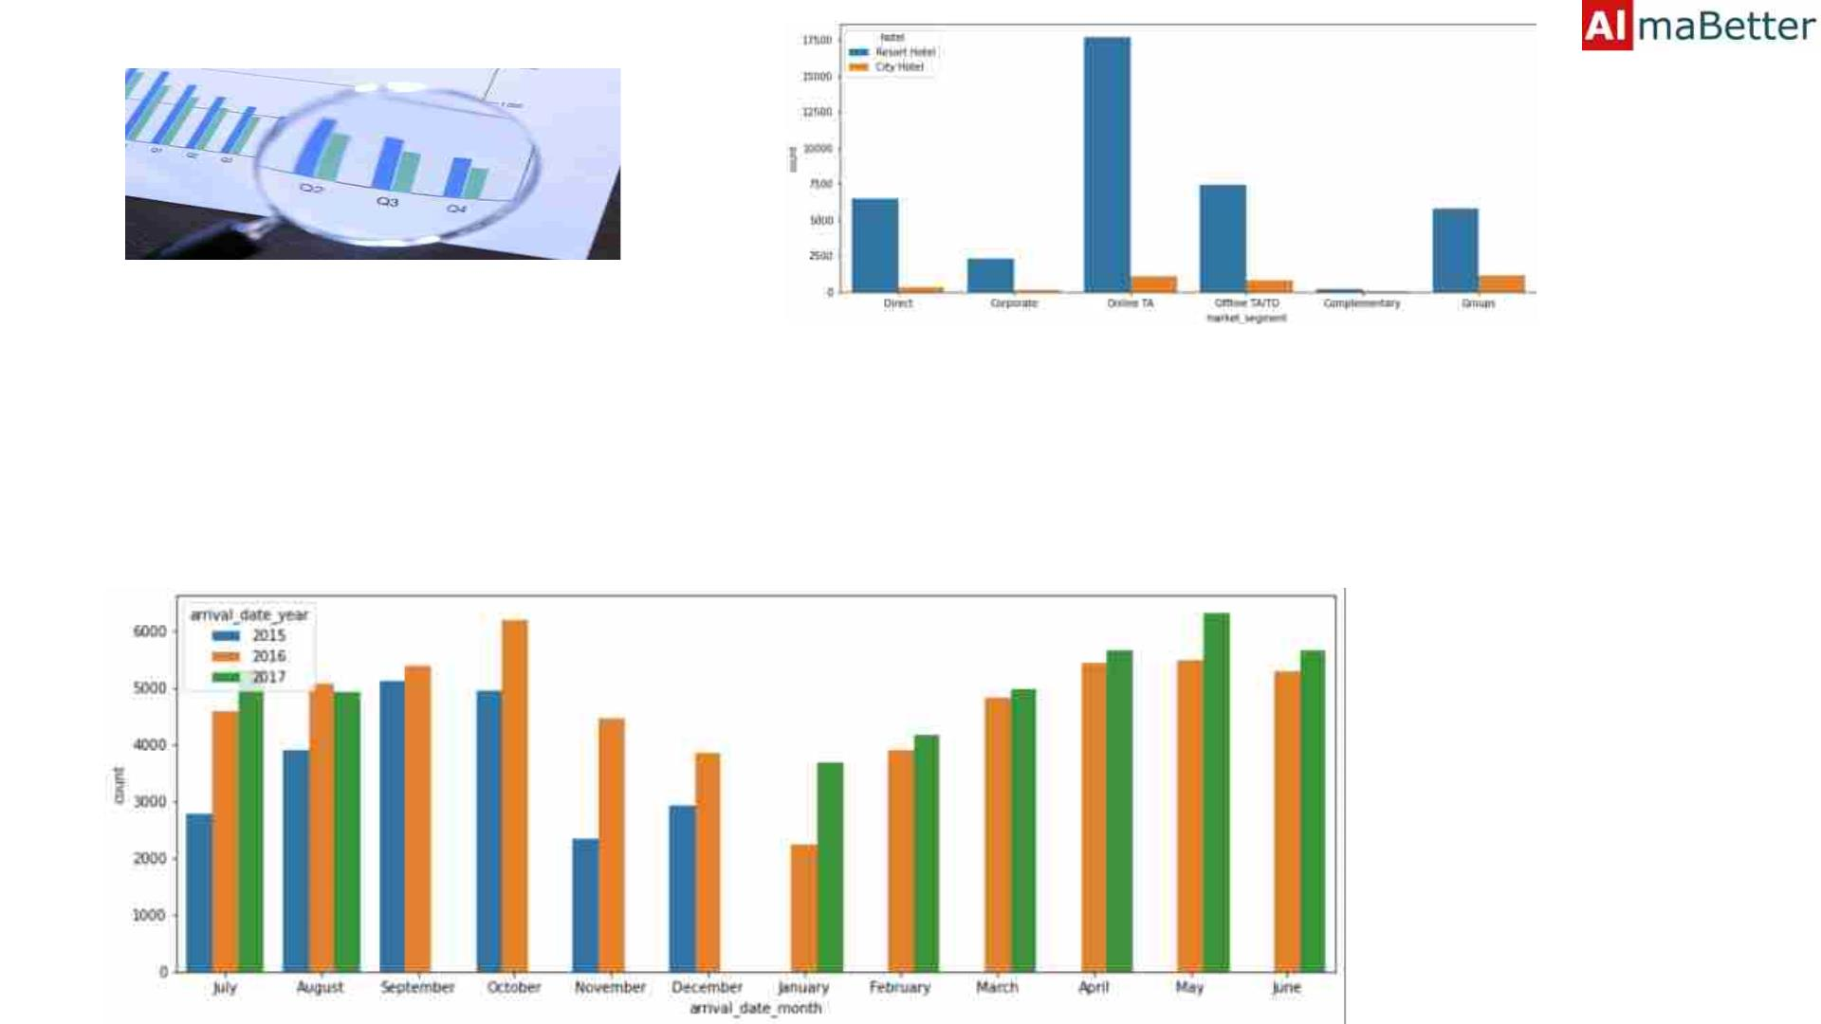
• Rooms booked by the Online Travel
Agents/offices(Online TA/TO) are having
Highest Number of Bookings in
comparison of the offline Travel
Agent/Travel Offices(Offline TA/TO).
• The Customers generally likes to came in
the month of October and May

Slide 13
Hotel Wise Analysis:-
• While doing the Hotel Wise Analysis of the given hotel booking
dataset, we tried to figured answering the following questions:
1. Percentage of the bookings in each hotels?
2. Which hotel makes more revenue?
3. Which hotel has higher booking cancellations rates?
4. What is most preferred stay length in each hotel?
5. What is the preferred stay time by the Customers?

Slide 14
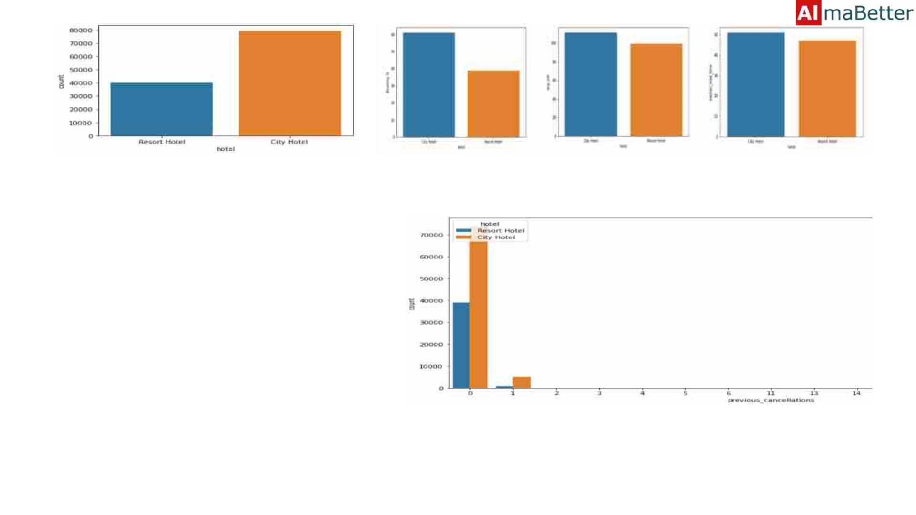
•
•
•
•
Nearly around 60% bookings are for the
City hotel and 40% bookings are for the
Resort hotel.
The City hotel has significantly higher
bookings , hence City Hotel is much
busier than Resort Hotel.
The City Hotel is generating more
Revenue than the Resort type Hotel by
looking at the trend of booking analysis
Approximately 30 % of the City Hotel
bookings and 25 % of the Resort hotel
bookings got canceled.

Slide 15
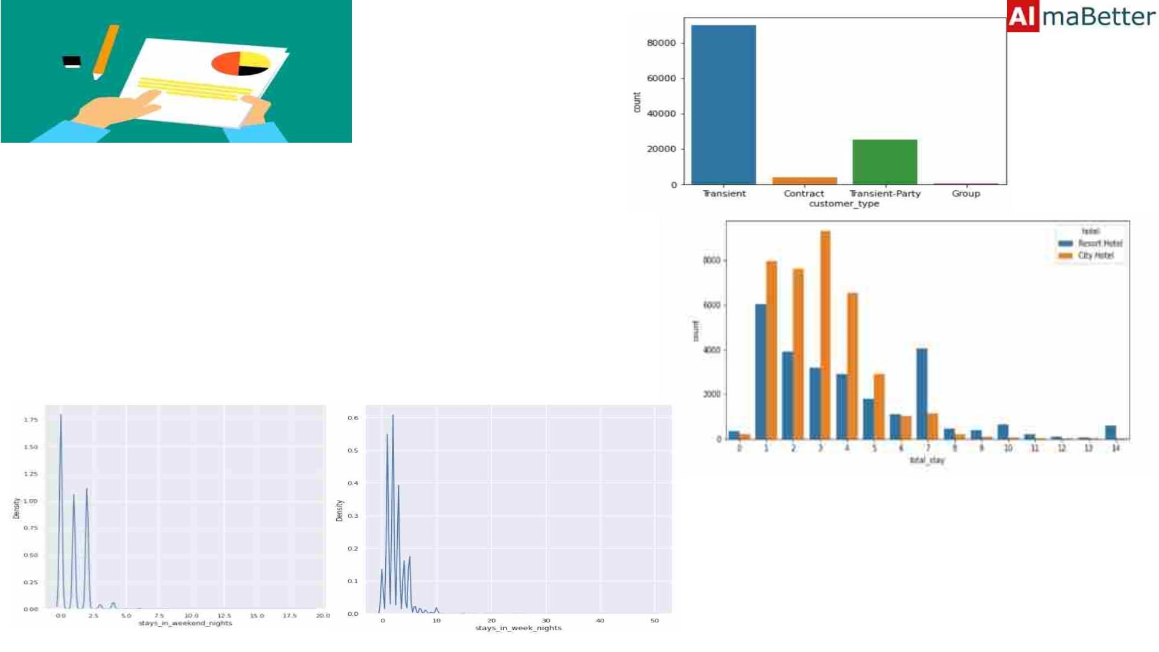
• There are many Transient(staying in
a place for a short period of time)
Customers stayed In the Hotels in
comparison of other guest categories.
• As per the Trends The Majority of the
stays are less than for the 5 days.
There are very few long stays at
hotels but Resort Hotel is preferred for
long stays.
• The Customers preferers to Stay at
weekend nights

Slide 16
Distribution Wise Analysis:-
While doing this set of the analysis of provided hotel booking dataset,
the Team Tried to find the answer of the following questions:
1. What is the most common channel for making the booking of the
hotels?
2. Which distribution channel generates more revenue deals for the
hotels?
3. Which channel does have more repeated Customers?

Slide 17
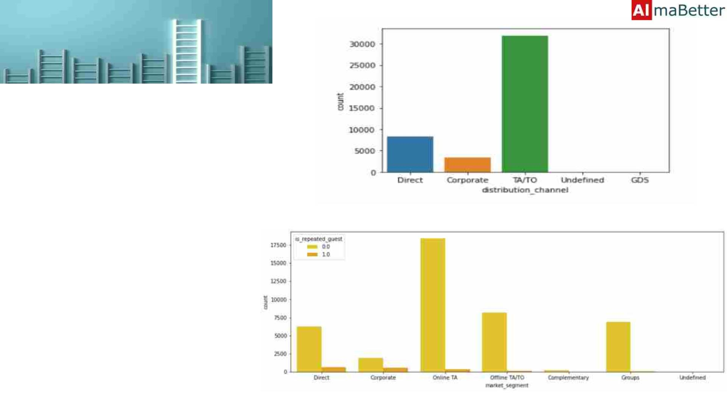
• As per the provided data set we can
clearly see that the most number of
the guest are doing the reservations
through TA(Travel Agency)/TO(Tour
Operator).
• The Second most booking Channel is
the Direct booking done by the
Customers at the Time of arrival.
• Hence, The most used Channel by
the Customers are the TA(Travel
Agency)/TO(Tour Operator) and the
TA/TO Channels are generating the
more Revenues to the Hotels.
• The online and offline TA(Travel
Agency)/TO(Tour Operator) are
having more numbers of the
repeated Customers.

Slide 18
Cancelation Analysis:-
While doing the Cancelation Analysis The team figured to do the
analysis and tried to answer the following:
1. Which distribution channel has highest the cancellation
percentage?
2. Reasons behind the Cancelation Occurs?
3. Which channels is affecting the most revenue of the Hotels?

Slide 19
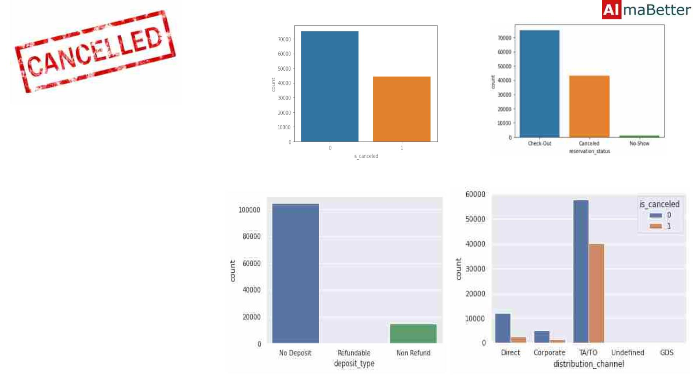
• While doing the Analysis we were
able to figure out that TA/TO has
highest booking cancellation
percentage. Therefore, a booking via
TA/TO is almost 28% likely to get
cancelled.
• There can be n reasons to get the
Hotel rooms to be cancelled, but
while looking at the Trend many
cancelation occurs during check in
and check outs the majority reason
can be that they are not getting the
same rooms which they have booked.
• Thus by looking at the Trend the
TA/TO are affecting the businesses
more.
• The Most number of the Cancellation
are done by not paying any deposits.
a

Slide 20
Time Wise Analysis:-
While doing the Time Wise Analysis The team figured to do the analysis
and tried to answer the following:
1. Which Months are the most busiest months for the hotels?
2. In which year the Highest Number of Bookings were Done?
3. What are the busiest days of the months in staying the Hotels?
4. Trends of booking Changes and Months of Arrivals?

Slide 21
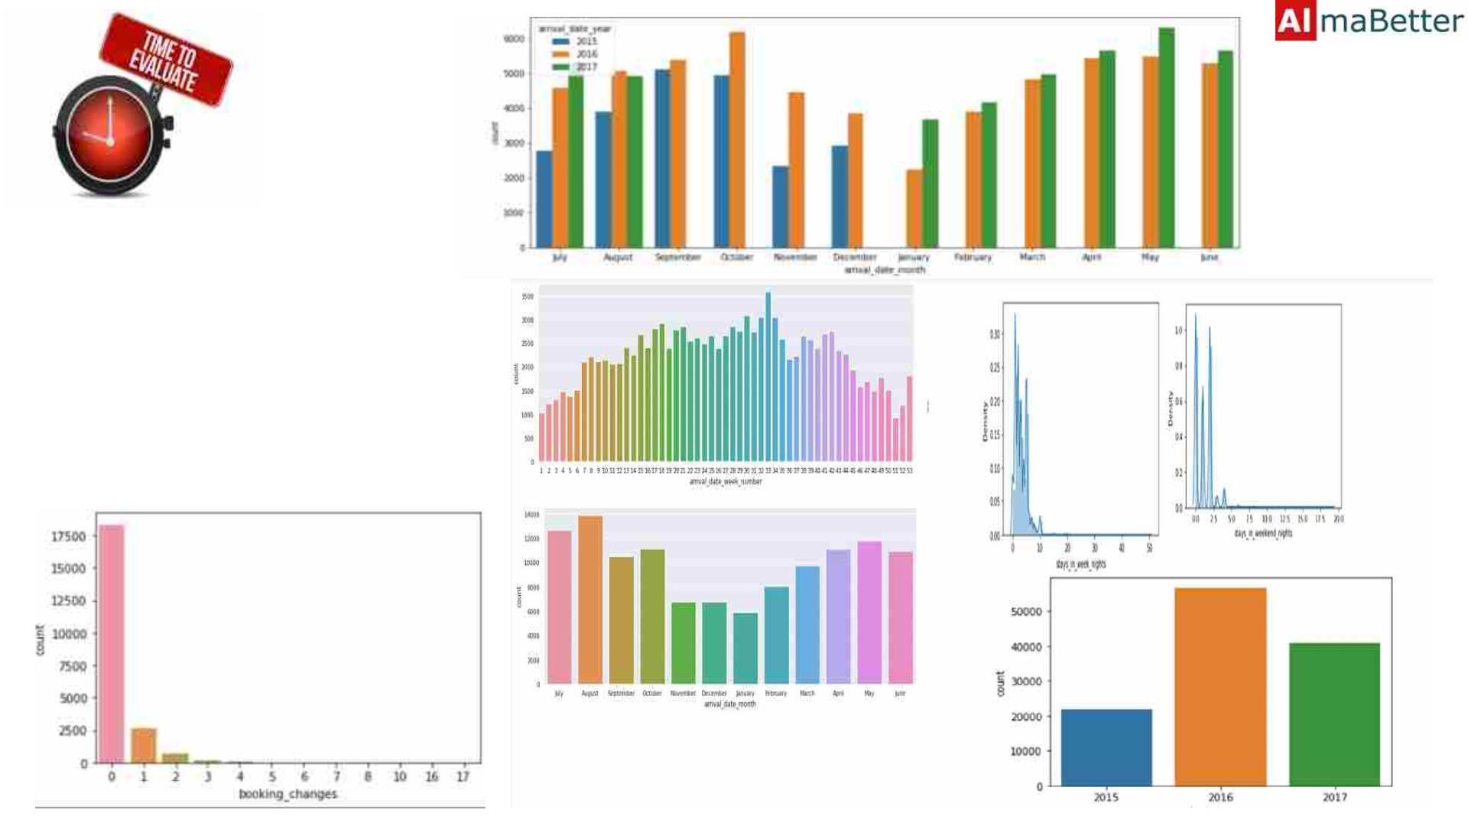
• The Year 2016 most number of the Hot
Rooms were booked as in comparison o
the year 2015 and 2017
• The Customers generally likes to came in
the month of October and May
• The Customers preferers to Stay at
weekend nights
• There are few customers who prefers
to make changes to the bookings

Slide 22

Summarization of Complete Theory:-
• Around 60% bookings are for City hotel and 40% bookings are for Resort hotel, therefore City Hotel is busier than
Resort hotel. Also the overall average daily rate and revenue of the City hotel is slightly higher than the Resort
hotel.
• Both hotels have significantly higher booking cancellation rates and very few guests less than 3 % return for
another booking in City hotel. 5% guests return for stay in Resort hotel.
• Customers used different channels for making bookings out of which most preferred way is TA/TO.
• July- August are the most busier and profitable months for the both of the hotels.
• Nearly 28% of bookings via TA/TO are cancelled.
• In the Year 2016 most Guest/Customers came to the Hotels.
• Customers preferred to stay in weekends rather than weekdays.
• Booking made by the TA/TO are Resulting the more repetition of the Customers.
• The Second most booking Channel is the Direct booking done by the Customers at the Time of arrival.
• City Hotels are more liked and booked by the Customers.

Slide 23
Q/A
Thank You

